Slide 1


Terraform: Infrastructure as Code
By Shivaramakrishna

Slide 2

What is Terraform?
HashiCorp Terraform is an infrastructure as code tool that lets you define both cloud and on-prem resources in human-readable configuration files that you can version, reuse, and share. You can then use a consistent workflow to provision and manage all of your infrastructure throughout its lifecycle. Terraform can manage low-level components like compute, storage, and networking resources, as well as high-level components like DNS entries and SaaS features

Slide 3
Why is Terraform?
It Automate and Manages the infrastructure.
It Manages the Platform.
Also Services running in it.

Slide 4
Key Features of Terraform
Declarative Syntax
Multi-Cloud Support
Modular Design
Terraform uses a declarative language to define infrastructure, making it easier to read, understand, and version control.
Terraform supports a wide range of cloud providers, including AWS, Azure, GCP, and more, allowing for seamless infrastructure management across platforms.
Terraform's modular architecture enables the creation of reusable, maintainable infrastructure components that can be easily shared and updated.

Slide 5

Infrastructure as Code (IaC)
1
Repeatability
2
Versioning
IaC ensures that infrastructure can be consistently and reliably provisioned, reducing the risk of human error.
IaC allows infrastructure to be tracked, versioned, and documented like software code, enabling better collaboration and change management.
3
Scalability
4
Automation
IaC makes it easier to scale infrastructure up or down as needed, adapting to changing business requirements.
IaC facilitates the automation of infrastructure provisioning, reducing manual effort and the potential for human error.

Slide 6
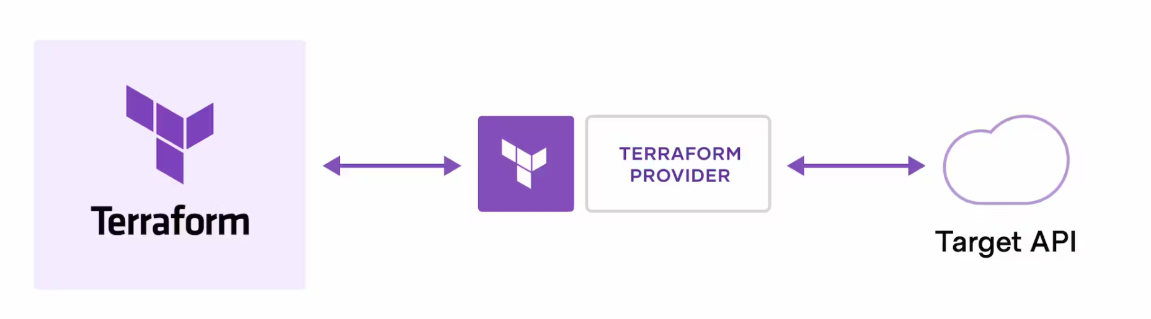
How does Terraform work?
Terraform creates and manages resources on cloud platforms and other services through their application programming interfaces (APIs). Providers enable Terraform to work with virtually any platform or service with an accessible API.

Slide 7
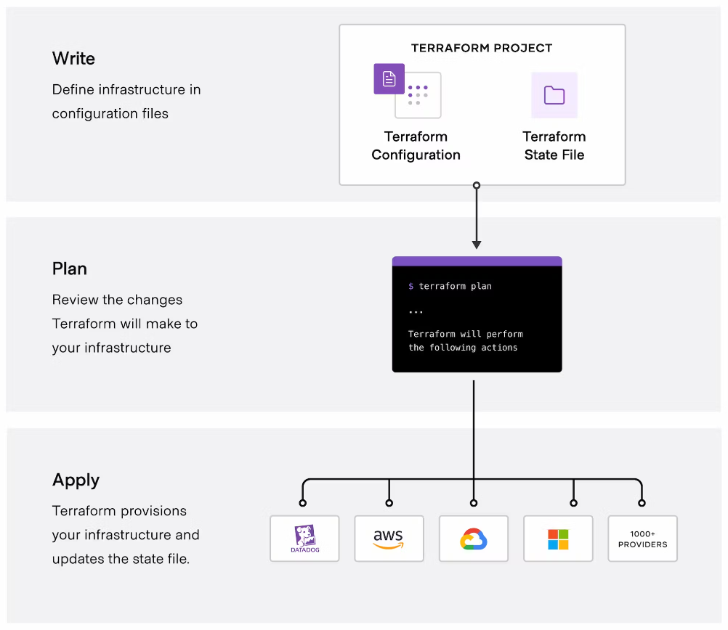
The Core
Terraform
Workflow
consists of
three stages:
Write
Plan
Apply

Slide 8

Terraform Workflow
1
Initialize
Set up the Terraform working directory and configure the backend for state management.
2
Plan
Preview the changes that Terraform will make to the infrastructure before applying them.
3
Apply
Execute the Terraform configuration to create, update, or destroy the specified infrastructure resources.

Slide 9





Terraform Providers
Cloud
On-Premises
Data Sources
Software
Terraform supports a wide range of cloud providers, including AWS, Azure, GCP, and more.
Terraform can also manage on-premises infrastructure, such as virtual machines and networking.
Terraform can interact with various data sources, like databases and APIs, to fetch and manage data.
Terraform can provision and manage software-based resources, like Kubernetes, Docker, and SaaS platforms.

Slide 10

Terraform Resources
Managed Resources
Data Sources
These are the core infrastructure components that Terraform can create and manage, such as virtual machines, networks, and databases.
Terraform can fetch data from external sources, like APIs or configuration files, to incorporate into the infrastructure definition.
Modules
Outputs
Reusable, composable Infrastructure as Code components that can be shared and deployed across multiple projects.
Values that can be extracted from the Terraform-managed infrastructure, such as resource IDs or endpoint URLs.

Slide 11




Terraform Variables
Input Variables
User-defined parameters that allow customization of the infrastructure definition.
Output Variables
Values returned by Terraform, which can be used by other systems or in the same configuration.
Environment Variables
System-level variables that can be used to configure Terraform's behavior or provide sensitive data.

Slide 12
Terraform Modules
Reusability
Maintainability
Collaboration
Modules allow you to encapsulate and reuse infrastructure components across multiple projects or teams.
Modules make it easier to update and manage infrastructure, as changes can be made in a centralized location.
Modules facilitate collaboration by enabling the sharing and versioning of infrastructure components.

Slide 13

Terraform State Management
1
Centralized State
2
Versioning
Terraform stores the current state of the infrastructure in a centralized location, which can be a local file or a remote backend.
The state file is versioned, allowing you to track changes and roll back to previous versions if necessary.
3
Locking
4
Drift Detection
Terraform's state locking mechanism prevents multiple users from modifying the infrastructure concurrently, reducing the risk of conflicts.
Terraform can detect when the actual infrastructure state differs from the desired state defined in the configuration.

Slide 14

Terraform Best Practices
1
Modular Design
Break down your infrastructure into reusable, composable modules to improve maintainability and scalability.
2
Consistent Formatting
Use a consistent code style and formatting to make your Terraform configurations more readable and understandable.
3
Sensitive Data Management
Store sensitive data, like API keys and passwords, in secure environments like HashiCorp Vault or AWS Secrets Manager.
4
Automated Testing
Implement automated testing, such as unit tests and integration tests, to ensure the reliability of your Terraform configurations.

